Slide 1
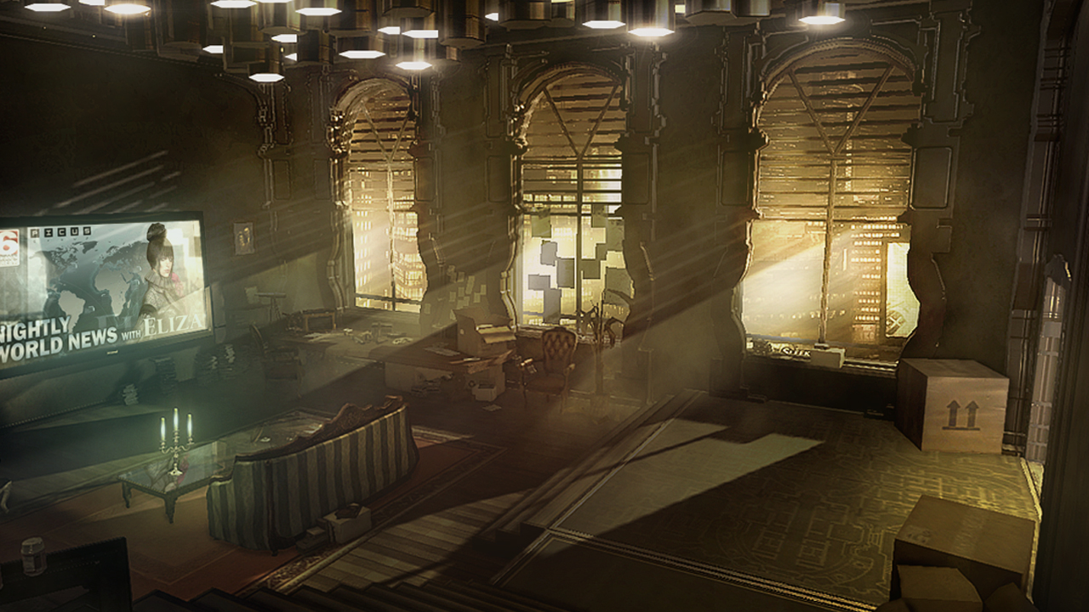
EVEREMOTE
DIStopia
Design Interactive Systems II
SS 2016

Slide 2
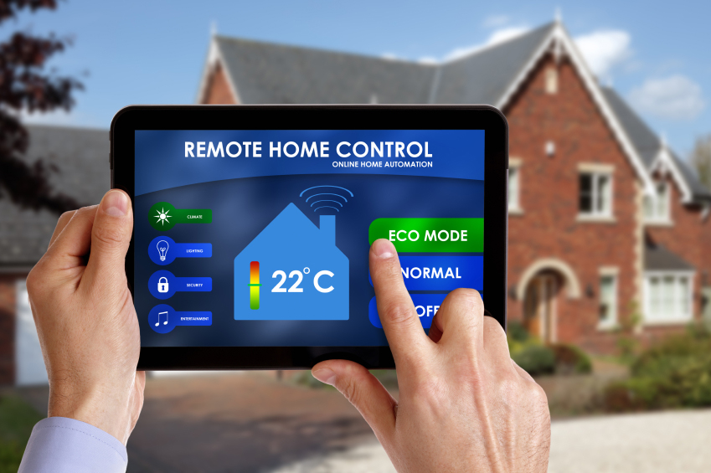
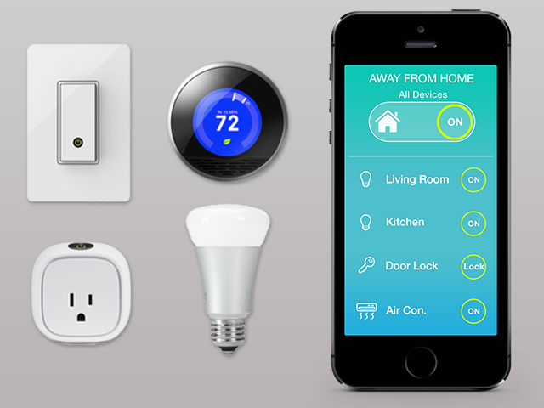
Home automation - It can be done better!
Overcomplicated complex remote applications with lots of functions.

Slide 3
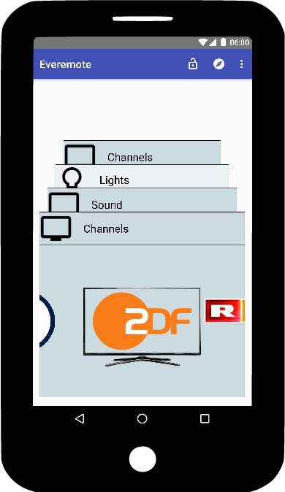
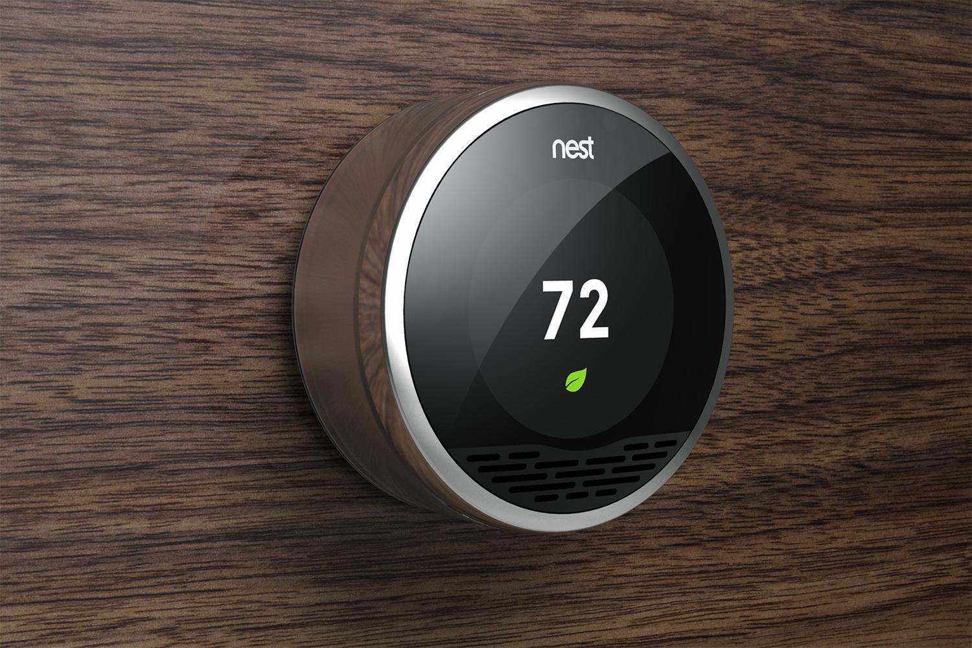
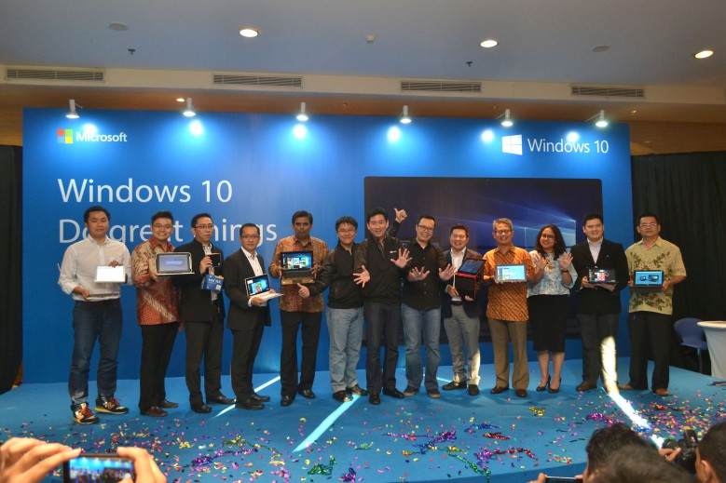
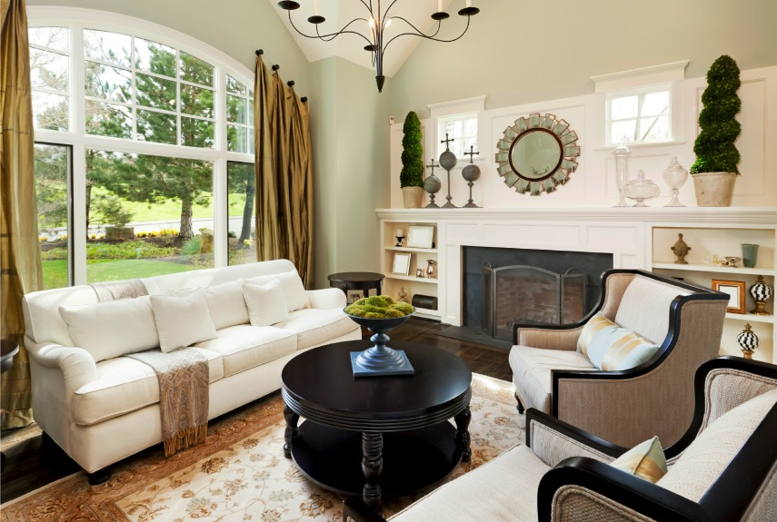
Introducing Everemote
Domain: Home automation
Users: Tech-savvy, between 20 and 50 (early majority)
Context: At home, probably in the living room

Slide 4
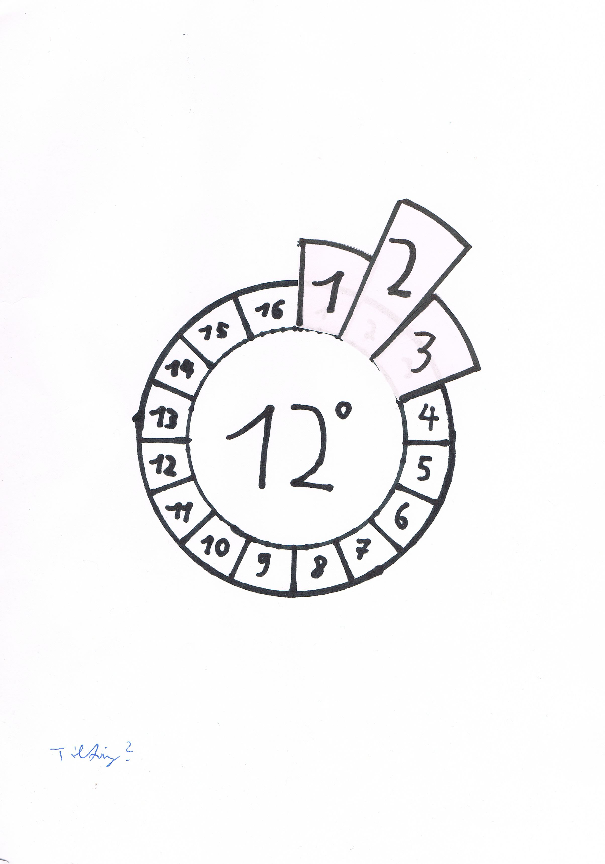
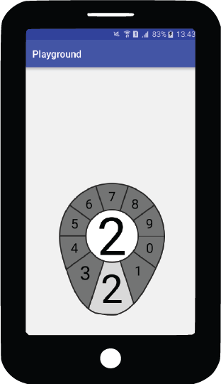
The widget set - Overview
Widget
Circular base
Linear base
Absolute circle widget
Volume widget
Absolute Regulator Widget
Banner slider widget
Flower widget

Slide 5
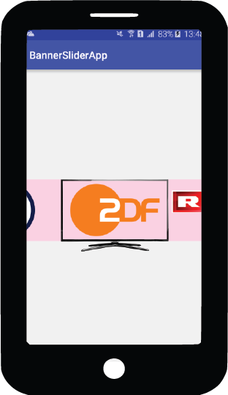
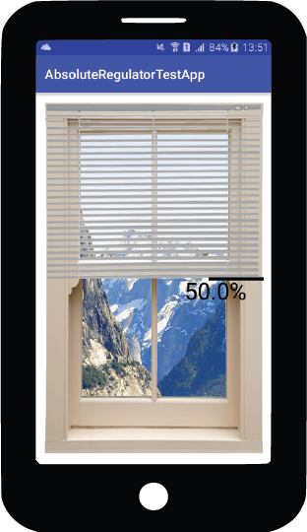
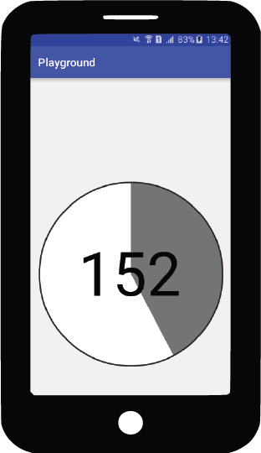
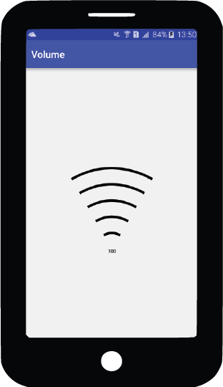
The widget set - Overview
TARGET: Pick up the main functionality of the controlled device.
Banner slider widget
Absolute Regulator Widget
Flower widget
Absolute circle widget
Volume widget

Slide 6
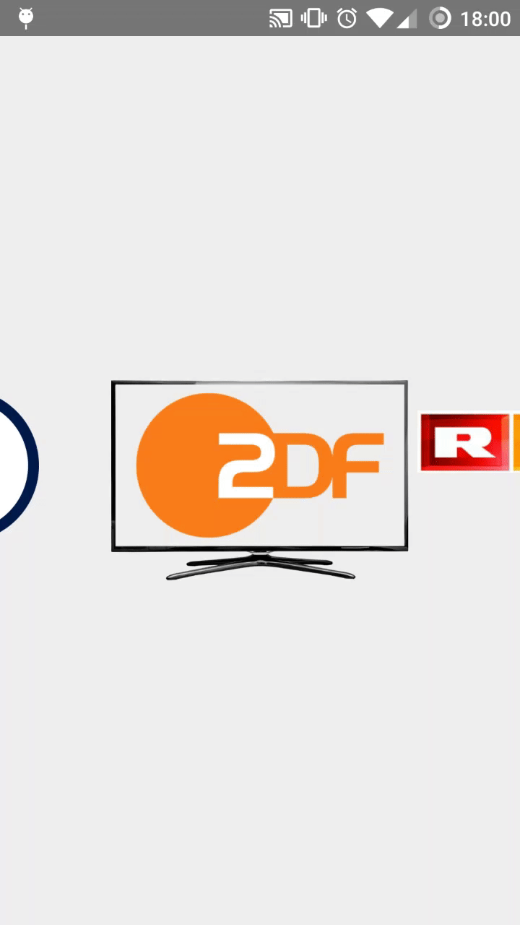
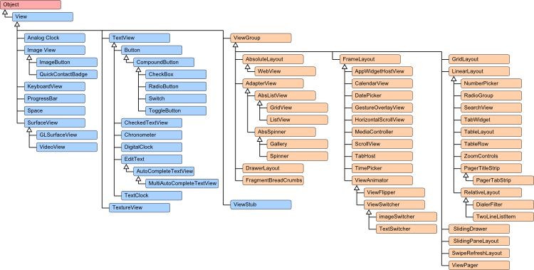
Deeper lookup: Banner Slider Widget
Extends the LinearLayout class provided by Android

Slide 7

Deeper lookup: Banner Slider Widget
Design rationale:
Show the controlled device in the center: Natural mapping
Hint the previous and next elements: Signifying swipeability
Only allowing images as subviews: Constraining the dev to good visibility
Keep in mind: Usage scenario!

Slide 8
Everemote – Demo time!
Team DIStopia

